Slide 1
Human Geography Research
CR 1: Rose-redwood, R. & L. Kadonaga (2016). “The corner of avenue A and twenty-third street”: geographies of street numbering in the united states, the professional geographer 68(1): 39-52.

Slide 2
Learning objectives
Describe a critical review paper
Identify different street plans and numbering
Engage in discussion of empirical research article (30 minutes)
Groups of 4
Pick leader
Pick note taker
Reflect on Discussion Questions in Debriefing (20-25 minutes)

Slide 3
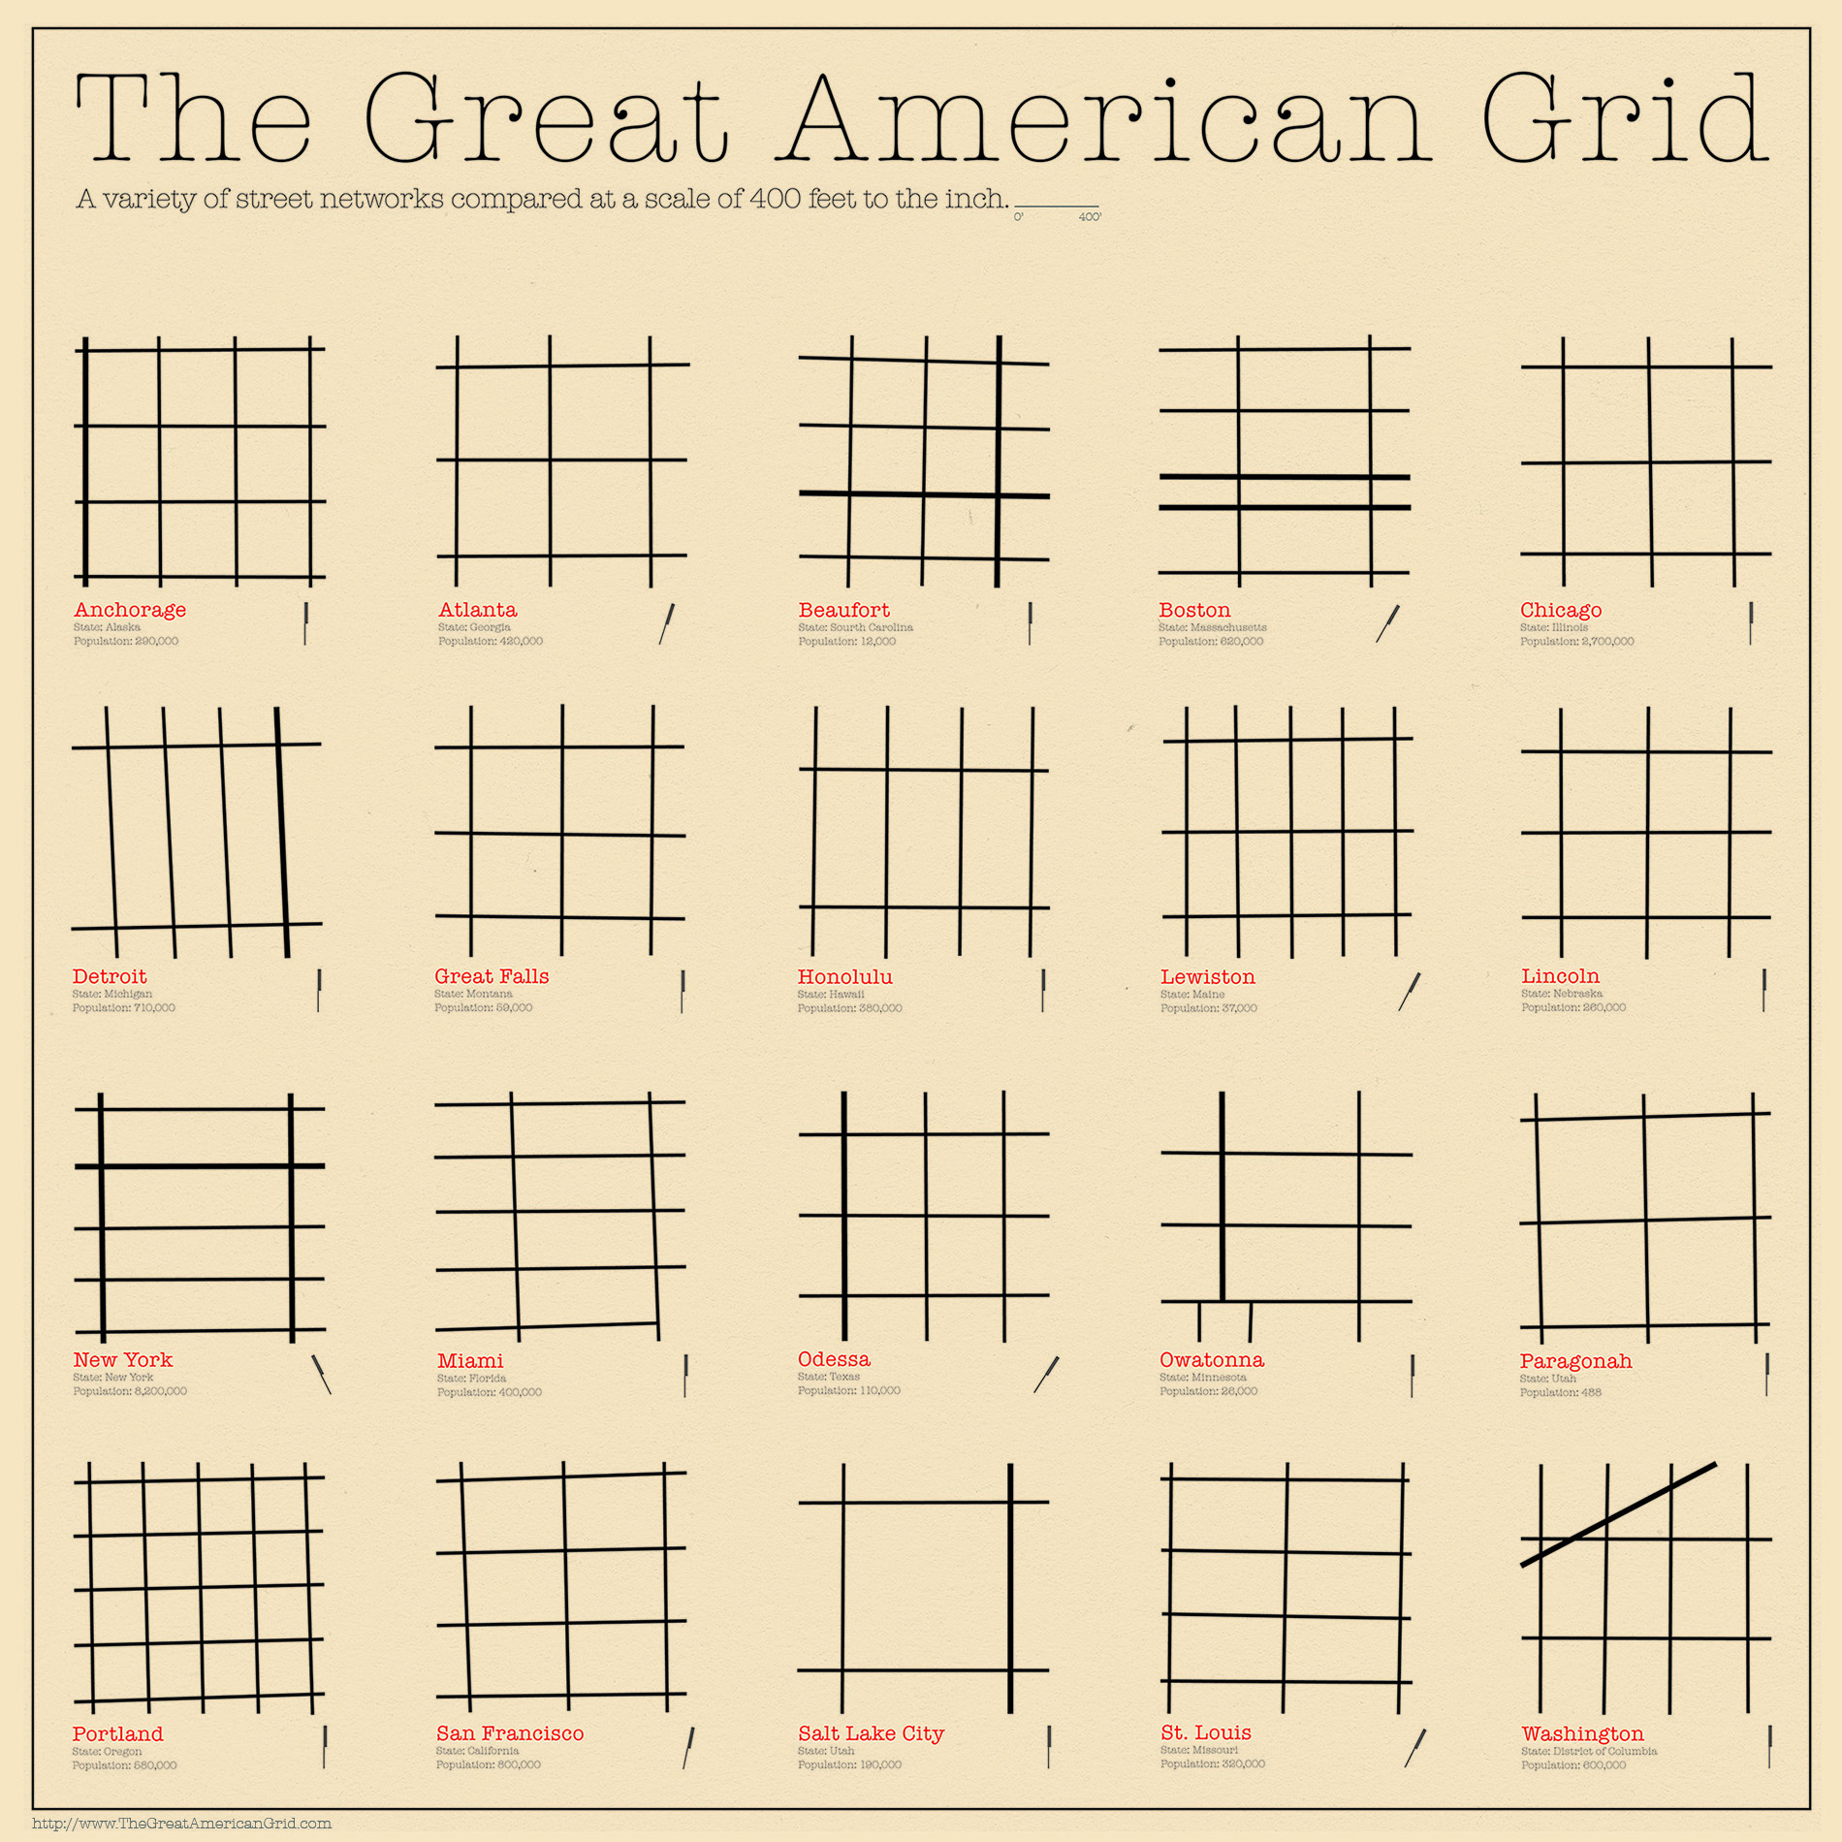

Slide 4
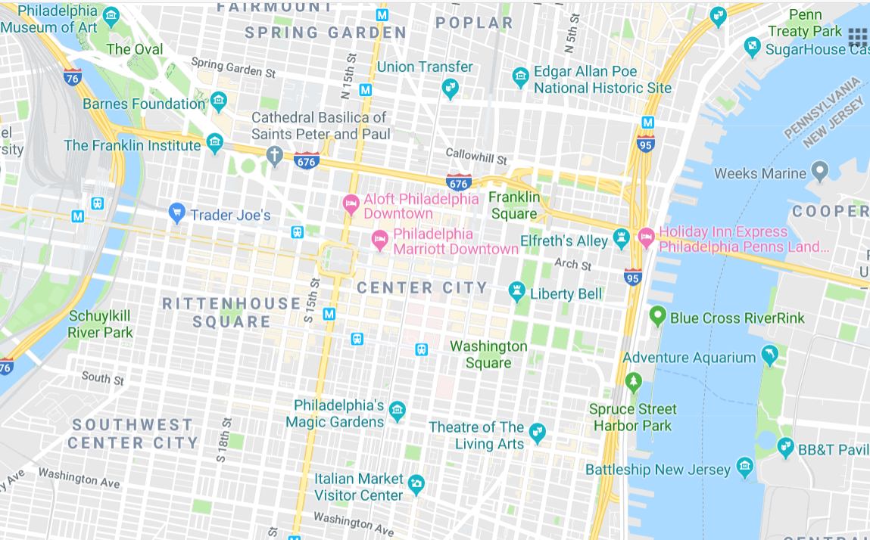

Slide 5
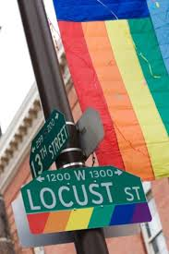
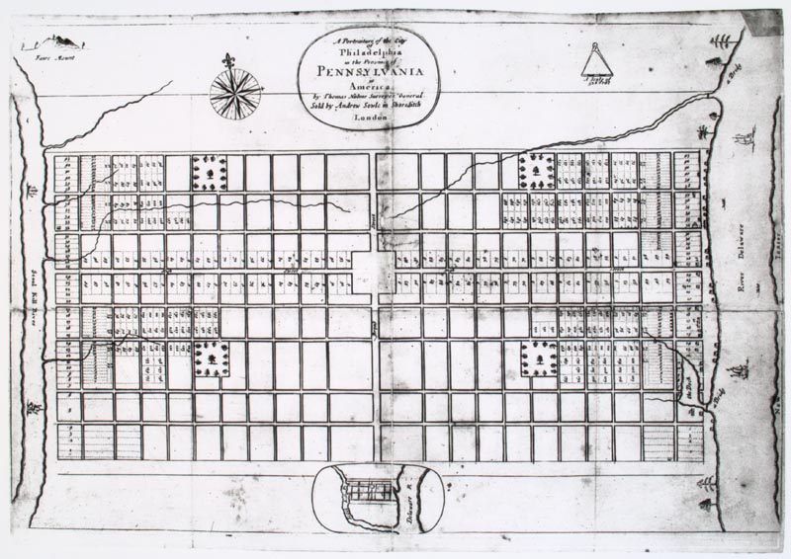
Photo by J. Smith for GPTMC, GoMag 2007
Thomas Holme - http://xroads.virginia.edu/~cap/PENN/pnplan.html

Slide 6
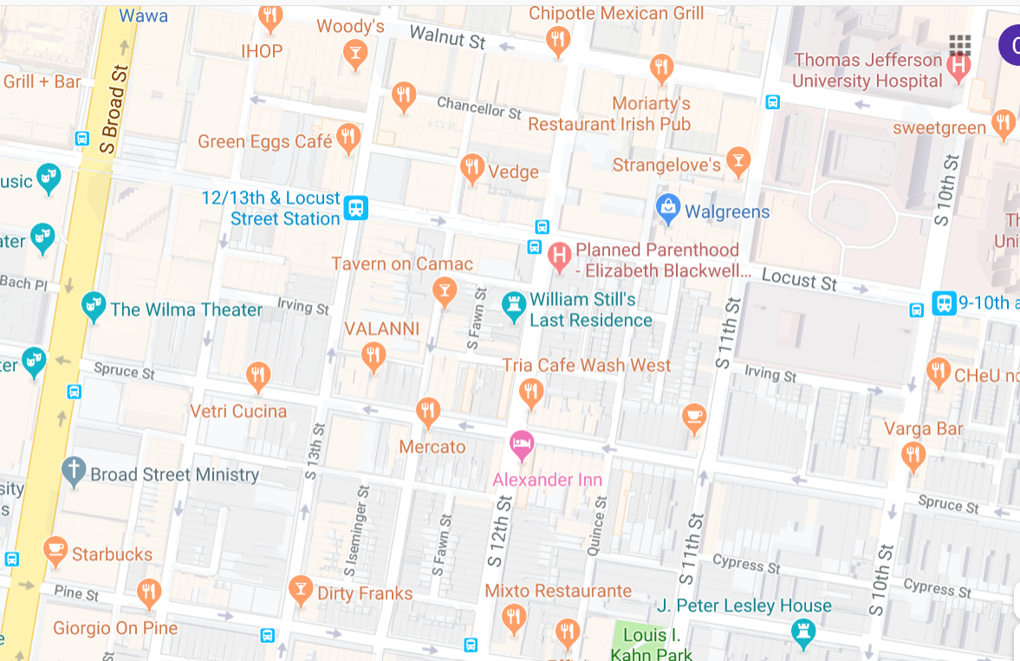
Grid pattern and naming: numbered north-south streets, names of trees east-west streets.

Slide 7
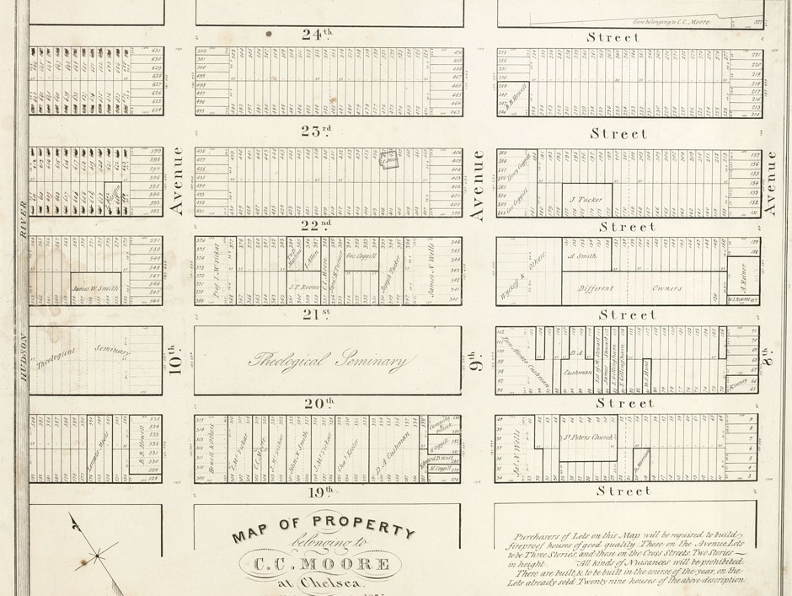
The Greatest Grid: The Master Plan for Manhattan, 1811
Jaffe, 2011, CityLab https://www.citylab.com/design/2011/11/visual-history-manhattans-grid/541/

Slide 8
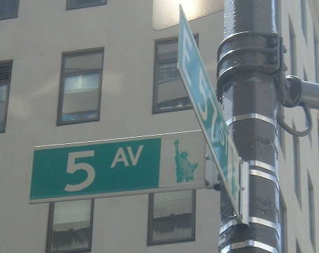
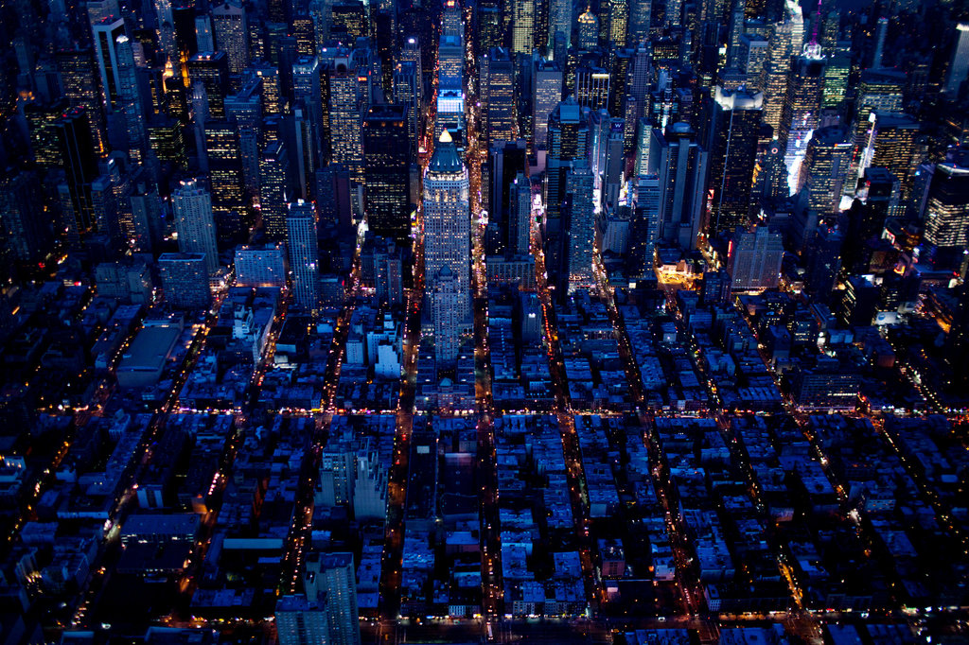
CITY OF ANGLES The street grid gave developers and, later, tourists order, access and predictability. It has proved surprisingly resilient, accommodating motor vehicles and Central Park. Credit Todd Heisler/The New York Times
Roberts 2011 https://www.nytimes.com/2011/03/21/nyregion/21grid.html
Wikimedia Commons, Accessed 2019

Slide 9
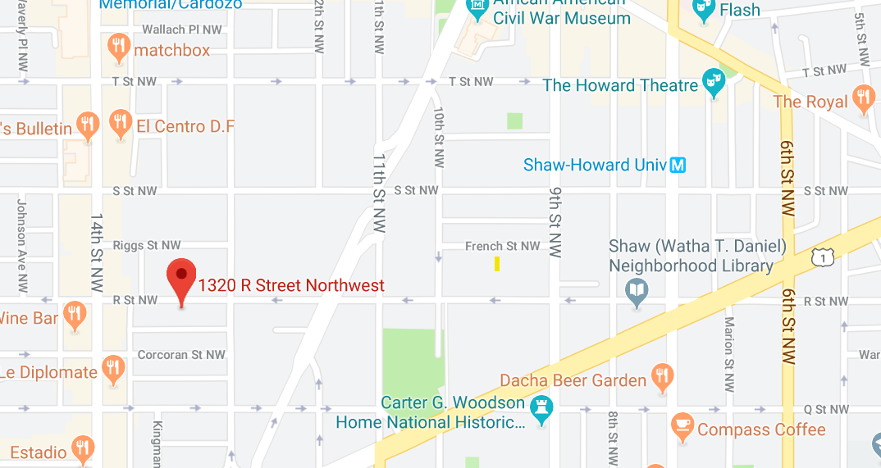
Grid pattern: At its center is the US Capitol. The streets running north and south are numbered, and the east-west streets are lettered beginning at the Capitol and extending in both directions. Washingtonian 2008. https://www.washingtonian.com/2008/02/22/driving-in-dc-a-crash-course-on-the-grid-system/

